Slide 1
Indeterminate Form and Improper Integral Session 23-25
Course : MATH 6031 - Calculus
Year : 2021

Slide 2

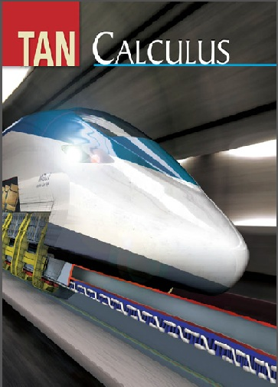
These slides have been adapted from: Dale Varberg, Edwin Purcell, Steve Rigdon. 2007. Calculus. Prentice Hall. ISBN: 978-0132306331. Soo.T.Tan. Calculus. 2010. Brooks/Cole. ISBN-13: 978-0-534-46579-7
Acknowledgement

Slide 3

Learning Objectives
LO 3:
Explain the properties of integral to describe geometric and physical problems, and other applications.

Slide 4
Outline
1
Indeterminate Forms of Type 0/0
2
Other Indeterminate Forms
3
Improper Integrals: Infinite Limits of Integration
4
Improper Integrals: Infinite Integrands

Slide 5


Indeterminate Forms 0/0 and ±∞/ ± ∞
Theorem
Example
If $\lim_{x→a}{f}(x)=±∞$and $\lim_{x→a}{g}(x)=±∞$, then the $\lim_{x→a}{\frac{f(x)}{g(x)}}$
is said to be an indeterminate form of the type ∞/∞, ∞/-∞, -∞/∞, or -∞/-∞.
If $\lim_{x→a}{f}(x)=0$
and $\lim_{x→a}{g}(x)=0$,
then the $\lim_{x→a}{\frac{f(x)}{g(x)}}$
is called an indeterminate form of the type 0/0.

Slide 6

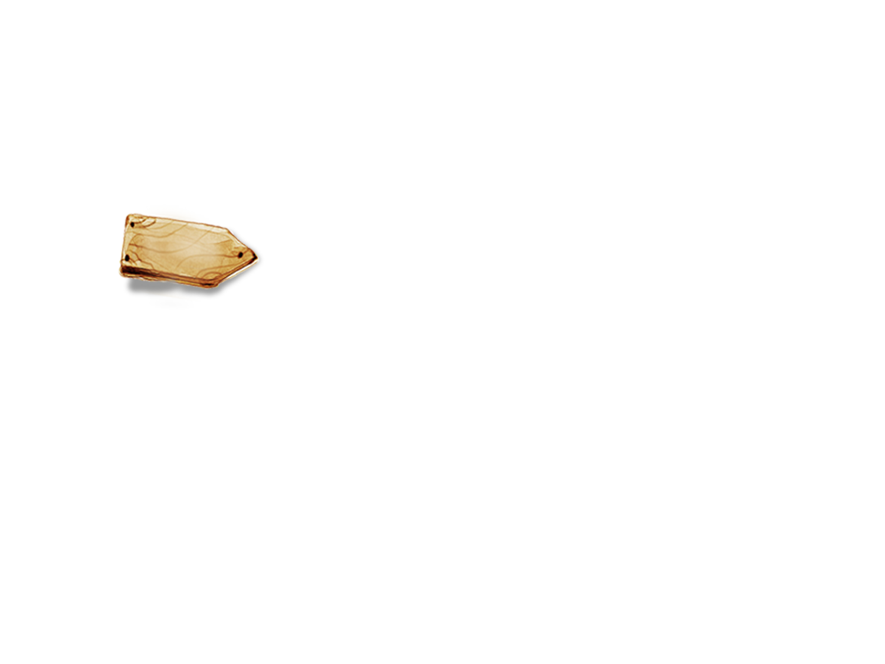
L’Hopital’s Rule
Theorem
Suppose that f and g are differentiable on an open interval I that contains a, with the possible exception of a itself, and g’(x) ≠ 0 for all x in I.
If
is an indeterminate form of the type 0/0 or ∞/∞, then
provided that the limit on the right-hand side exists or is infinite.

Slide 7
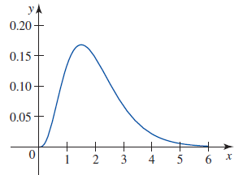
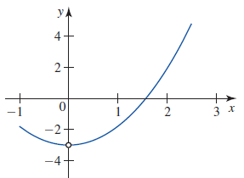


Example
$$\lim_{x→∞}{\frac{x^{3}}{e^{2x}}}=\lim_{x→∞}{\frac{3x^{2}}{2e^{2x}}} (\text{Type} ∞/∞) \\ =\lim_{x→∞}{\frac{6x}{4e^{2x}}} (\text{Type} ∞/∞) \\ =\lim_{x→∞}{\frac{6}{8e^{2x}}} =0$$
$$\lim_{x→0}{\frac{x^{3}}{x−\tan{x}}}=\lim_{x→0}{\frac{3x^{2}}{1−\sec^{2}{x}}} (\text{Type} 0/0)$$
$$=\lim_{x→0}{\frac{6x}{−2\sec^{2}{x}\tan{x}}} (\text{Type} 0/0)$$
$$=\lim_{x→0}{\frac{6}{−4\sec^{2}{x}\tan^{2}{x}−2\sec^{4}{x}}} =−3$$

Slide 8

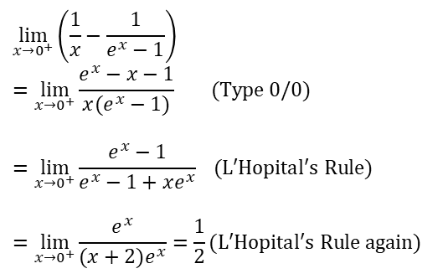
Indeterminate Forms ∞ - ∞ and 0. ∞
∞ - ∞ 0. ∞
$$\lim_{x→0^{+}}\left(\frac{1}{x}−\frac{1}{e^{x}−1}\right)$$
$$=\lim_{x→0^{+}}{\frac{e^{x}−x−1}{x(e^{x}−1)}} (\text{Type}\text{ 0/0})$$
$$=\lim_{x→0^{+}}{\frac{e^{x}−1}{e^{x}−1+xe^{x}}} (\text{L}\text{′}\text{Hopital}\text{′}\text{s} \text{Rule})$$
$$=\lim_{x→0^{+}}{\frac{e^{x}}{(x+2)e^{x}}}=\frac{1}{2}(\text{L}\text{′}\text{Hopital}\text{′}\text{s} \text{Rule} \text{again})$$
$$\lim_{x→0^{+}}{x}\ln{x} \left(\text{type}\text{ 0.}∞\right)$$
$$=\lim_{x→0^{+}}{\frac{\ln{x}}{1/x}} (\text{Type} ∞/∞)$$
$$=\lim_{x→0^{+}}{\frac{1/x}{−1/x^{2}}} (\text{Apply} \text{L}\text{′}\text{Hopital}\text{′}\text{s} \text{Rule})$$
$$=\lim_{x→0^{+}}{−}x=0$$

Slide 9
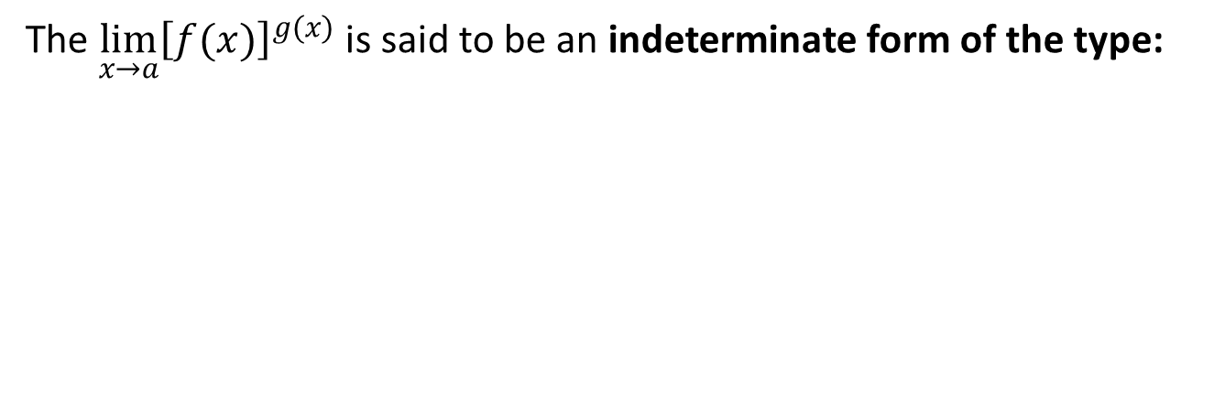
The Indeterminate Forms 0⁰, ∞⁰, and 1∞
The ${\lim_{x→a}\left[f(x)\right]}^{g(x)}$ is said to be an indeterminate form of the type:
0⁰ if :
∞⁰ if :
1∞ if :

Slide 10


Example
1st step
2nd step
We have an indeterminate form of the type 1∞ for ${\lim_{x→∞}\left(1+\frac{1}{x}\right)}^{x}$
Let $y={\left(1+\frac{1}{x}\right)}^{x}$then
$$\ln{y}={\ln\left(1+\frac{1}{x}\right)}^{x}=x\ln\left(1+\frac{1}{x}\right)$$
So
$$\lim_{x→∞}{\ln{y}}=\lim_{x→∞}{x}\ln\left(1+\frac{1}{x}\right)$$
has an indeterminate form of the type 0.∞
Rewriting and using l’Hôpital’s Rule, to obtain
$$\lim_{x→∞}{\ln{y}}$$
$$=\lim_{x→∞}{x}\ln\left(1+\frac{1}{x}\right)$$
$$=\lim_{x→∞}{\frac{\ln\left(1+\frac{1}{x}\right)}{1/x}} (\text{Type}\text{ 0/0}) \\ =\lim_{x→∞}{\frac{1}{1+\frac{1}{x}}}=1 (\text{Apply} \text{L} \text{Hopital} \text{Rule})$$

Slide 11
Infinite Limits of Integration
1
2
3

Slide 12
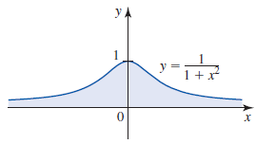
Example

Slide 13
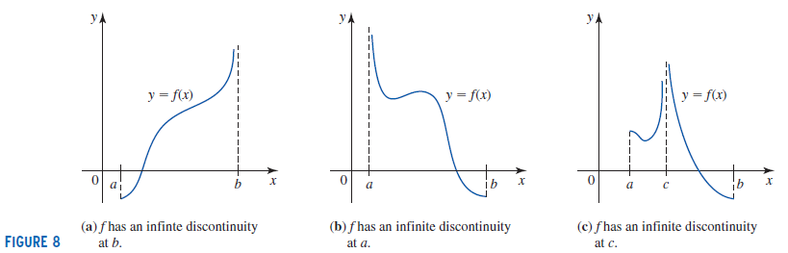
Infinite Discontinuities (1/3)
If f is continuous on [a,b) and f has an infinite discontinuity at b, then
provided that the limit exists.
The improper integral is convergent if the limit exists
and divergent if the limit does not exist.

Slide 14
Infinite Discontinuities (2/3)
If f is continuous on (a,b] and f has an infinite discontinuity at a, then
provided that the limit exists.
The improper integral is convergent if the limit exists
and divergent if the limit does not exist.

Slide 15
Infinite Discontinuities (3/3)
If f has an infinite discontinuity at c, where a < c < b, but f is continuous elsewhere on [a,b] and f has an infinite discontinuity at a, then
provided that the limit exists.
The improper integral on the left is convergent if both improper integrals on the right are convergent and divergent if one or both improper integrals on the right is divergent.

Slide 16
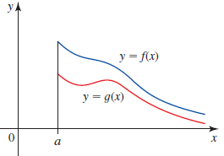



A Comparison Test for
Improper Integrals
Let f and g be continuous, and suppose that $f\left(x\right)≥g\left(x\right)≥0$ for all $x≥a$; that is, f dominates on [a,∞]
If
$$\int_{a}^{∞}{f(x)}dx$$
is convergent, the so is
$$\int_{a}^{∞}{g(x)}dx$$
If
$$\int_{a}^{∞}{g(x)}dx$$
is divergent, the so is
$$\int_{a}^{∞}{f(x)}dx$$

Slide 17
Dale Varberg, Edwin Purcell, Steve Rigdon. 2007. Calculus. Prentice Hall. ISBN: 978-0132306331.
Dale Varberg, Edwin Purcell, Steve Rigdon. 2014. Calculus Early Transcendentals. Pearson New International Edition. ISBN: 978-1-292-04268-8
Soo.T.Tan. 2010. Calculus. Brooks/Cole. ISBN-13: 978-0-534-46579-7

